Slide 1

Osric's Office & Appliances
Mohammed AlMuzel Martin Zanaj Jason Lu
Marco Seman
Audrey White
Maricruz Zamora

Slide 2
Overview of First Half
Define Problem (Current State, Future State, etc.)
Build ERD
Project Approval
Software Project Management Plan
Use Case Summary
Use Case Specification

Slide 3
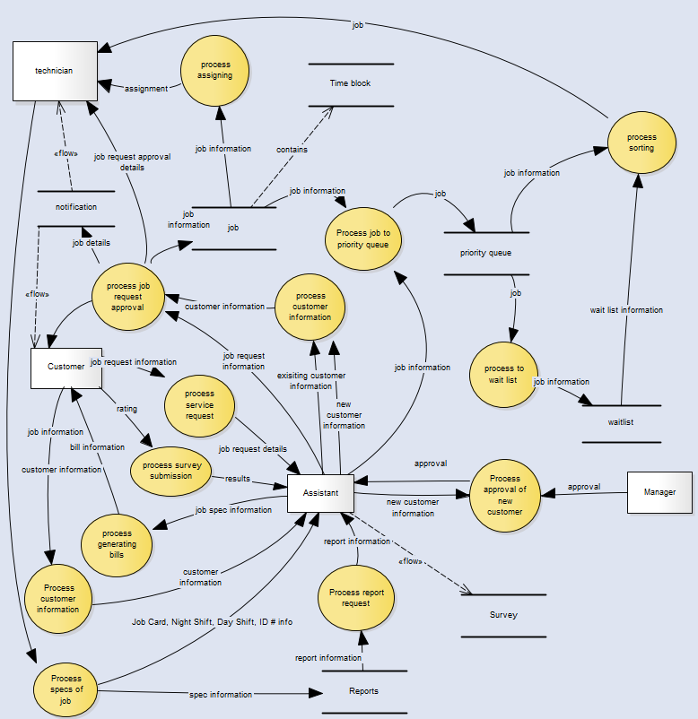
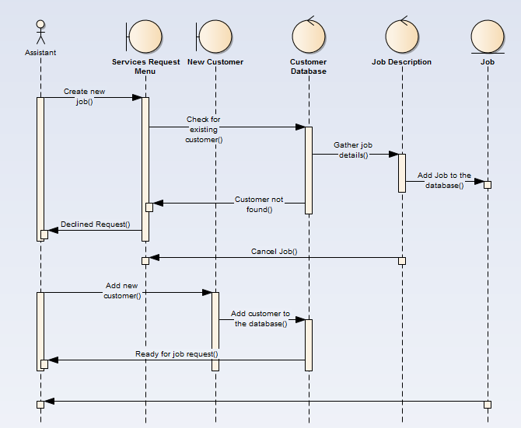
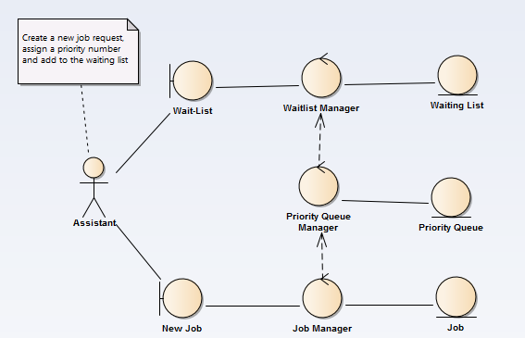
Software Requirement Specification
Examples of Data Flow, Sequence, and Communication Diagrams
Focused on software functionalities
Data flow diagram
Sequence, state, and communication diagrams
UML diagram
Formed basic foundations of the user interface

Slide 4
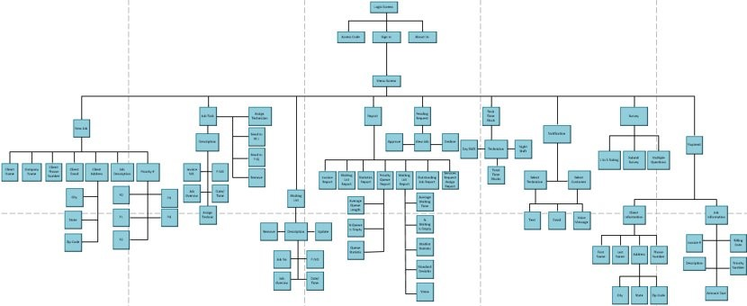
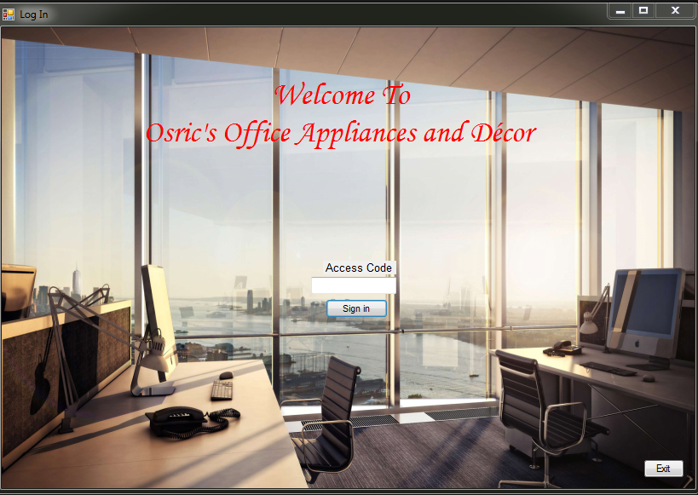
Design Document
System (Architectural) Design Diagram
Goal was to design demonstration prototype
Began with Architectual design of entire system
Decomposition diagram
Detailed (component-level) design
Data design
Result was a Graphical user interface using Windows Form Application and C#
GUI Design (Login Screen)

Slide 5
Test Plan
Test # | Test Type | Input | Expected Output and/or Action | Actual Output and/or Action | Pass/Fail Decision
1 | Black Box Testing | Button Event Handler. The user will select exit to return to the main menu | Every interface should have the ability to go back to the main menu screen7f | We had the ability to return to the main menu | Pass
2 | Boundary Testing | Zip Code | Email Invalid (if no @ entered). Does not allow user to enter more than 15 characters for name, no more than 5 for Zip code, and no more than 10 for phone number. Error: Missing Input (for blank boxes) | Zip Code–only allows 5 charc. | Failed
 |  | Name |  | Name-only allows 15 charc.
 |  | Phone Number |  | Phone Number- only allows 10 char.
 |  | Email |  | Email-no message for not entering @
3 | Boundary Testing | Correcting failed in test case 2 : Email | Email Invalid (if no @ entered) | Error message “*Error:INVALID EMAIL” | Pass
4 | Top-Bottom Testing | Button Event Handler, and Login Access | Check and see if every function is accessible by first logging in, and then checking if all the button event handlers are working as anticipated. | All button event handlers take you to the appropriate window | Pass
5 | Unit Testing | User login access code | (Attempting incorrect user login) | Displays error message “Authorization Fail! Try Again.” | Pass
 |  | mp000000
6 | Unit Testing | User login access code | The user is logged in | The main menu appears, giving the user the option | Pass
 |  | m0001

